Slide 1
Calculations of Input-Output Resistance for BJT
Cascade Amplifier Circuits

Slide 2
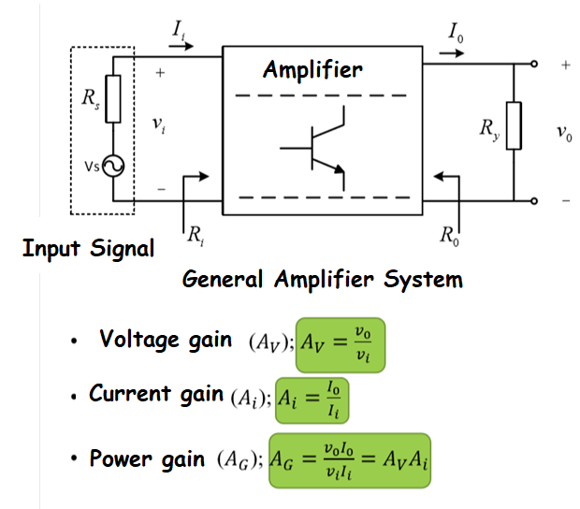
Block Diagram of Amplifier
General Definitions
Vs: Input Signal (sourse)
Rs: Source intrinsic resistance
Ri :Input resistance of amplifier
R0: Outpur resistance of amplifier
Ii:Input current
I0:Output current
Vi: Input voltage
V0:Output voltage

Slide 3
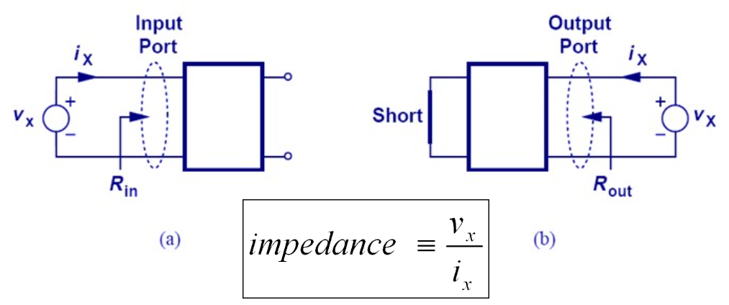
Input/Output Resistance
All independent sources are made zero.

Slide 4
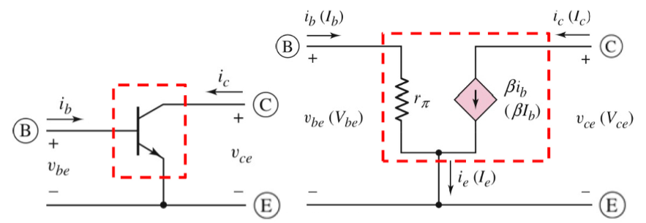



Small signal model of bipolar transistor

Slide 5
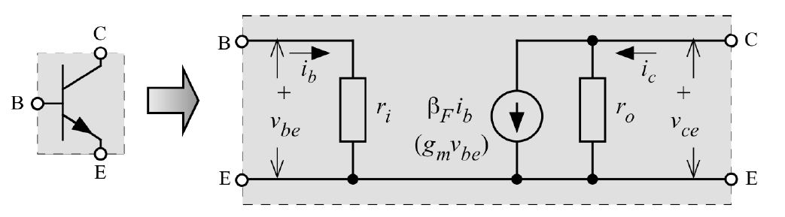
Small signal model of bipolar transistor

Slide 6
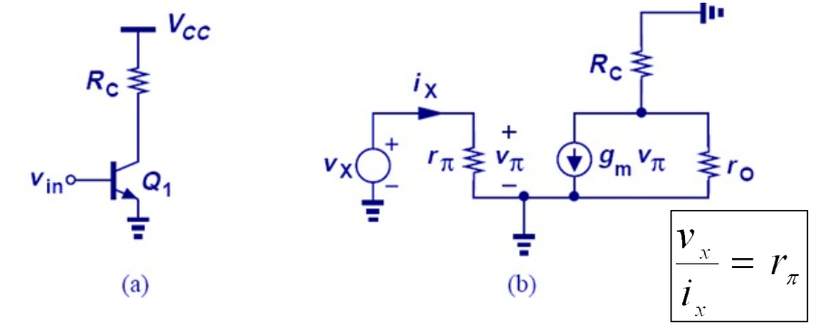
Input/Output Resistance
The input impedance is obtained by applying a small change in the input voltage and finding the changes occurring in the input current.

Slide 7
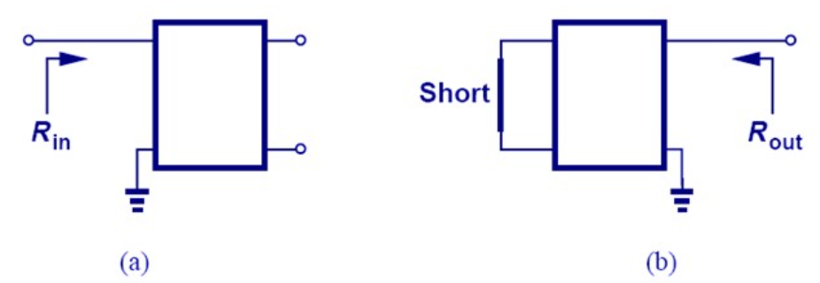
Impedance in a node:
When the impedance in a node is to be calculated, a terminal is grounded.
It is generally referred to as "impedance seen in a node" rather than the impedance between the two nodes.

Slide 8
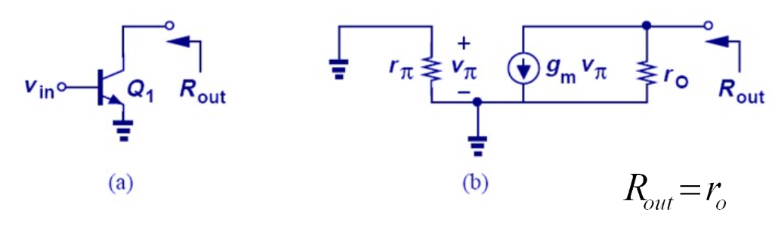
Equivalent impedance seen at the collector node:
If the emitter end is grounded, the equivalent impedance seen from the collector node of the transistor is the output resistance of the transistor.

Slide 9
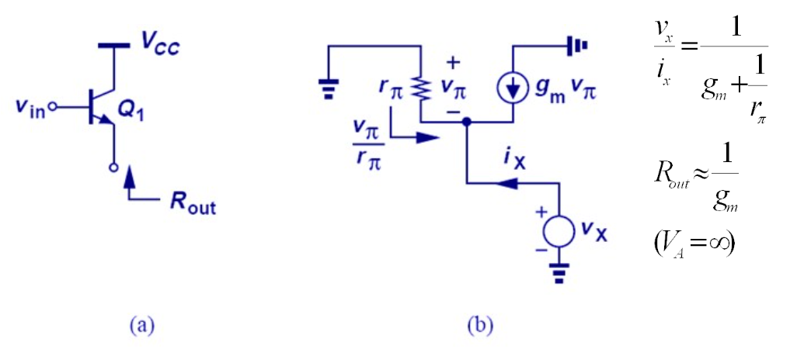
Equivalent impedance seen from the emitter
When the base terminal is short-circuit, the equivalent impedance seen from the emitter terminal becomes approximately the opposite of the trans-conductance.

Slide 10


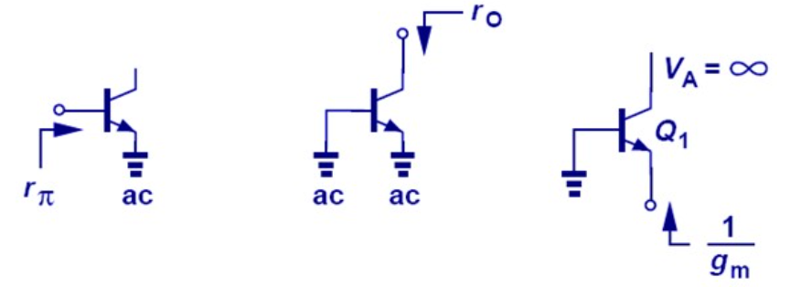
Equivalent impedances seen from different ends of BJT:
Equivalent impedance seen from the base terminal:
Equivalent impedance seen from the collector terminal :
Equivalent impedance seen from the emitter (If the early tension is neglected):

Slide 11

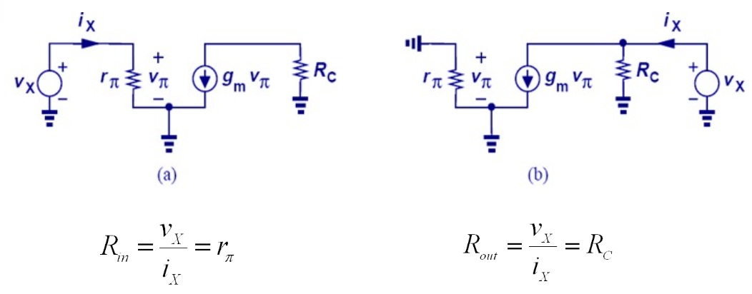
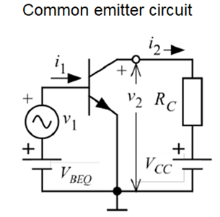
Input / Output Resistors for CE Configuration
When the output resistance is calculated, the input node is short-circuit. :

Slide 12
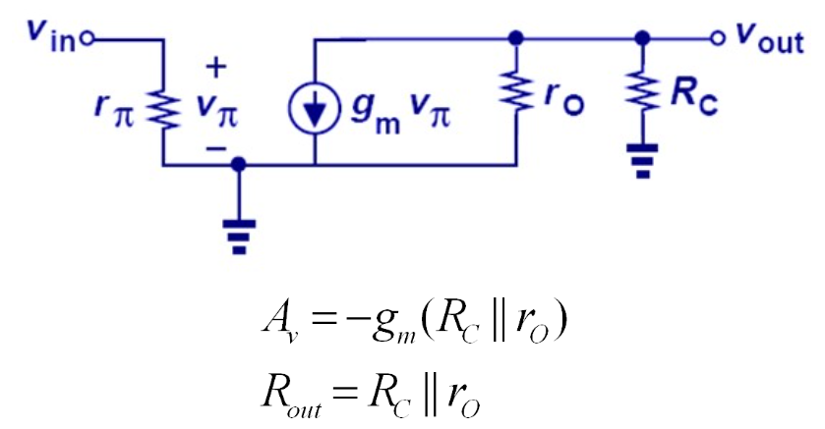
Considering the Early effect:
Early effect in CE configuration reduces voltage gain.

Slide 13

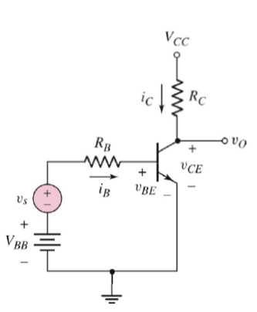
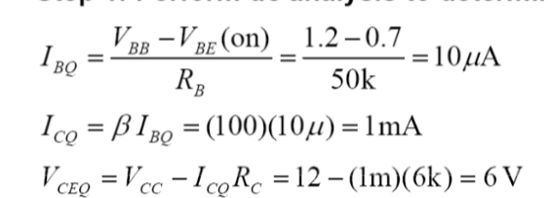

Problem
Calculate the voltage gain, input and output resistance of the circuit below.
When the circuit's DC analysis is done:
Circuit works in Active region.

Slide 14
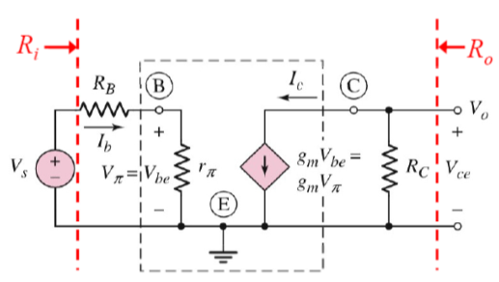
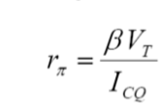



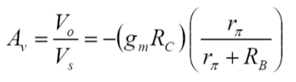
Solution:

Slide 15

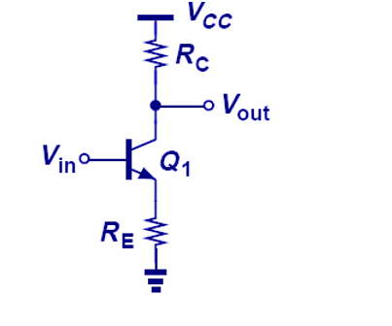
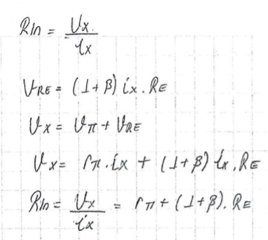

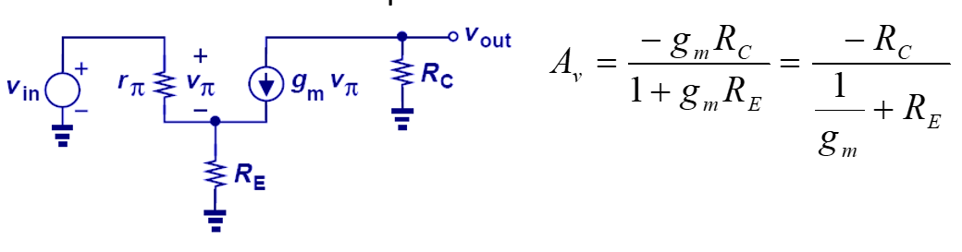

Slide 16
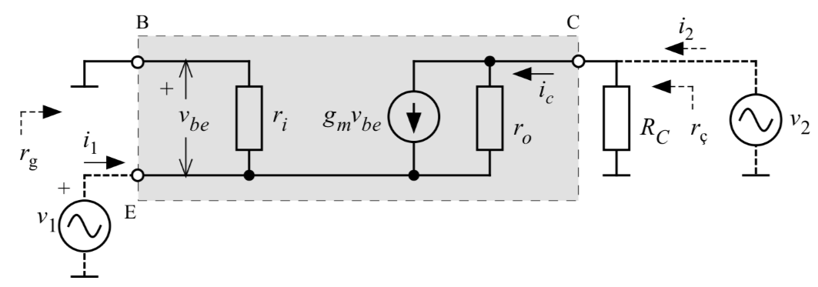
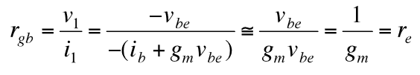

Input / Output Resistance of Common Base (CB) Configuration

Slide 17
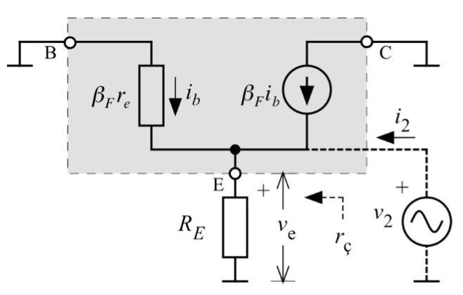



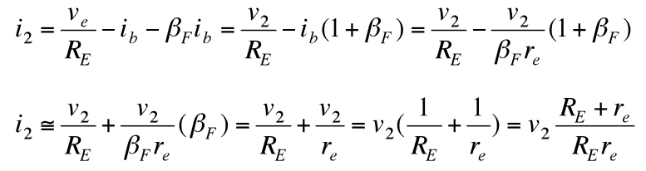
Input / Output Resistance of Common Collector Configuration
Input Resistance
Output Resistance

Slide 18
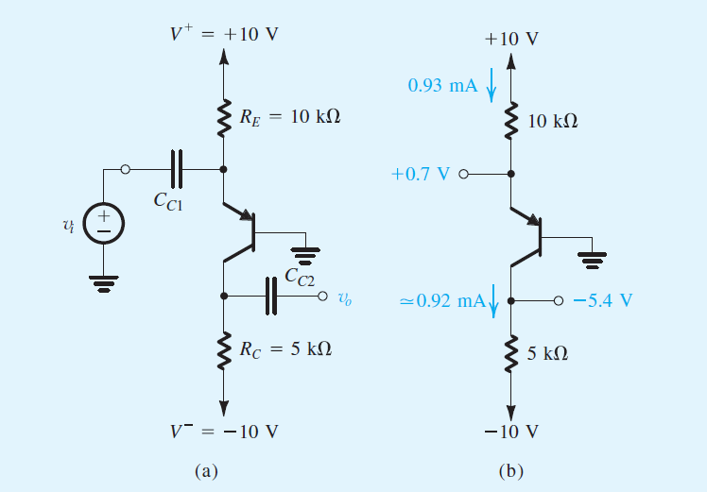
Example

Slide 19
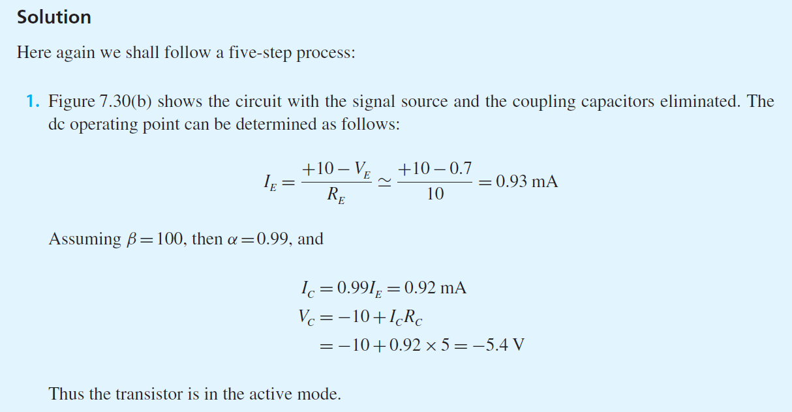

Slide 20
